Slide 1
Truths we must tell ourselves to manage climate change
Robert Socolow
Princeton Environmental Institute
Faculty Seminar Series
February 6, 2018

Slide 2
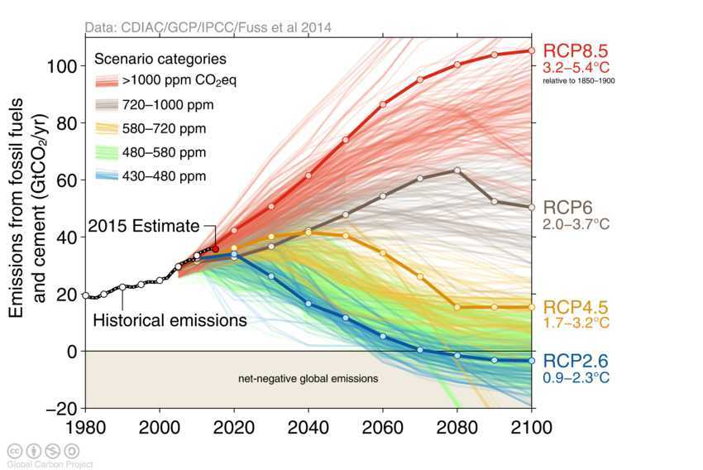
What we project, and how far

Slide 3
What we project, and how far
Destiny Studies is the systematic exploration of humanity’s collective future.
It has the potential to transform today’s toxic public discourse and muted academic discourse.

Slide 4
CO₂ emissions scenarios

Slide 5
The Freshman Seminar 151 capsules
Reunions:
0
10
25
50
2046 is also PU #300.

Slide 6
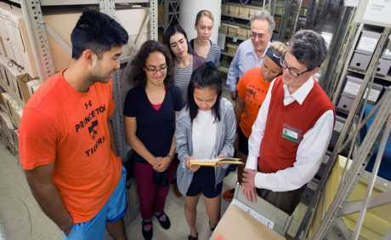
“Time capsules for climate change, to be opened at your reunions”
Student’s topics:
Sea level rise and cities
Solar radiation management
Carbon dioxide removal
Solar power
Batteries
Electric Cars
Mudd Library
Photo credit: Denise Applewhite
Each student wrote about two alternative futures: Will the electric car dominate or find only niches? They interviewed people with a range of views: How will the Catholic Church deal with geoengineering?
“It’s up to us.”

Slide 7
The climate change problem
Doing ordinary things, we are changing the planet.
Because our climate science is so unsettled, the best and worst outcomes of what we are doing are dramatically different.
High-carbon industrialization in the developing countries is the Number One problem. (Note: politically charged.)

Slide 8
Our small planet
O GtCO₂ 1600 3200 4800
More than a century
AA few decades
A few more decades
1ºC, already
2ºC
3ºC
A useful approximation: The long-term average temperature rise on the Earth’s surface is proportional to the cumulative global emissions of CO₂. 2ºC is the most discussed target. G = 10⁹.
The multiplier from emissions to temperature rise reveals that our planet is small. When we as a species do ordinary things* globally with the technologies we have, we harm ourselves. *Examples of ordinary things: eating hamburgers, commuting to work, building with concrete, going skiing.
1. We wish Earth were larger.
Notes:
BAU is faster than a continuation of the upward diagonal line, if we equate BAU and RCP 8.5. RCP 8.5 hits 80 GtCO2 in 2060 (doubling in 40 years) and is 100 GtCO2/yr in 2100 (growth having slowed down)
MENTION DEFFEYES.

Slide 9
Carbon budgets
O GtCO₂ 1600 3200 4800
More than a century
AA few decades
A few more decades
1ºC, already
2ºC
3ºC
“Hubbert peak”
equivalent
Add one rectangle:
40 billion tCO₂/yr* 40 yrs
40
≈2ºC
40
≈3ºC
1600
1600
1600
1600
1600
1940
2020
2100
1940
2020
2060
2140
In memoriam: Ken Deffeyes (1931 – 2018).
Notes:
BAU is faster than a continuation of the upward diagonal line, if we equate BAU and RCP 8.5. RCP 8.5 hits 80 GtCO2 in 2060 (doubling in 40 years) and is 100 GtCO2/yr in 2100 (growth having slowed down)

Slide 10
Carbon budgets
O GtCO₂ 1600 3200 4800
More than a century
AA few decades
A few more decades
1ºC, already
2ºC
3ºC
“Hubbert peak”
equivalent
Add one rectangle:
40 billion tCO₂/yr* 40 yrs
40
≈2ºC
40
≈3ºC
1600
1600
1600
1600
1600
1940
2020
2100
1940
2020
2060
2140
If we were not confronting climate change, the era of fossil fuels (coal, oil, and gas) could last hundreds of years.
What if, in 2018, we had still not figured out CO₂?
Notes:
In memoriam: Kenneth Deffeyes (1931 – 2018).
BAU is faster than a continuation of the upward diagonal line, if we equate BAU and RCP 8.5. RCP 8.5 hits 80 GtCO2 in 2060 (doubling in 40 years) and is 100 GtCO2/yr in 2100 (growth having slowed down)

Slide 11
Budgets demand choices
The budget concept leads inexorably to choices about which fossil fuels to extract and which to consider “unburnable”:
  When? Better options someday?
  Whose? Geopolitical stability
  Used where? “Fairness”
  For what purpose? Who judges?
  Which fossil fuels? Those with the highest H/C ratio?
2. Judgments about which fossil fuels are “unburnable” have no precedents.

Slide 12
Risk management and the “tails”
550 ppm: 50% chance of 3ºC, but 1/6 chance < 2ºC. Lucky!
450 ppm: 50% chance of 2ºC, but 1/6 chance of > 3ºC. Unlucky!
  A well known climate science leader, when I said, “We could be lucky,” replied: “You must never say that.”
The IPCC Fifth Assessment Report makes current uncertainty more transparent :
  “No best estimate for equilibrium climate sensitivity [the temperature rise for 550 ppm] can now be given because of a lack of agreement on values across assessed lines of evidence and studies.”
Source: WG1AR5, SPM FINAL, fn 16, p. 16.
*3. Risk management demands a global climate science effort that gives greater priority to extreme outcomes (the “tails”).

Slide 13
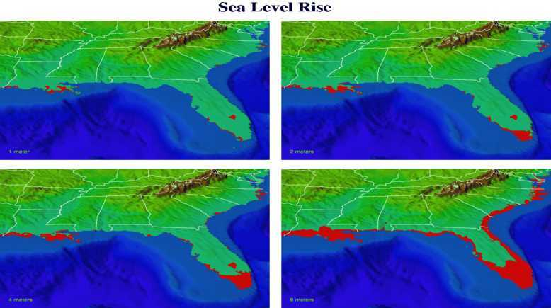
Sea level rise: When?
1 meter
2 meters
4 meters
8 meters
Greenland ice sheet: 7 meters
West Antarctic Ice Sheet: 5 meters
Reference pace for sea-level: +1 meter/century
Source: T. Knutson, Geophysical Fluid Dynamics Laboratory, NOAA. See:
http://www.gfdl.noaa.gov/~tk/climate_dynamics/climate_impact_webpage.html#section4
Notes:
Michael Schlessinger, July 2007:
Greenland ice sheet: 7 meters (23 feet)
West Antarctic Ice Sheet: 5 meters (17 feet)
East Antarctic ice sheet: 65 meters (214 feet).

Slide 14
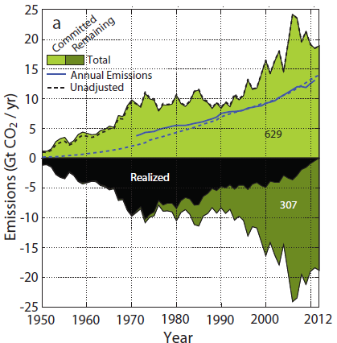
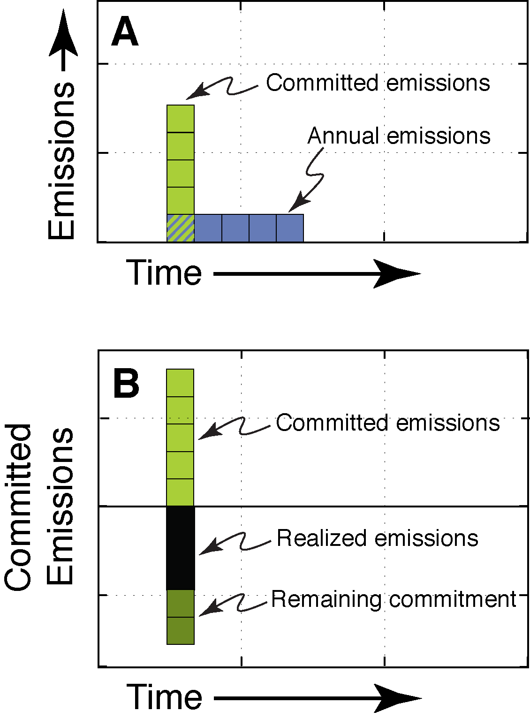
“Committed emissions”
Future emissions inherent in current investments
Remaining commitment
Collaborator: Steve Davis.
Source: Davis and Socolow, Env. Research Letters, 2014
Global view of electric power from 2012. Assumes 40-year life for power plants, updated for retirements and plant-life extensions.

Slide 15
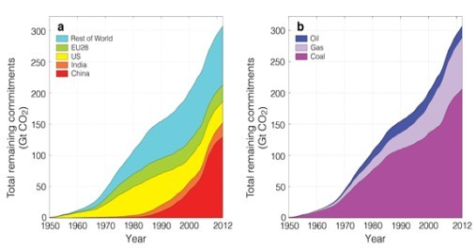
Remaining emissions, year by year
Total: 300 GtCO₂
U.S.
COAL
CHINA
CHINA
1950
2012
Global remaining “committed emissions” from then-operating power plants, 1950 – 2012. (Assumes a 40-year lifetime.)
A preliminary analysis updated by four years (to 2016) shows 355 GtCO₂ of remaining commitments, thus a continued 4%/year growth (Dan Tong, unpublished).
Collaborator: Steve Davis. Source: Davis and Socolow, Env. Research Letters, 2014

Slide 16
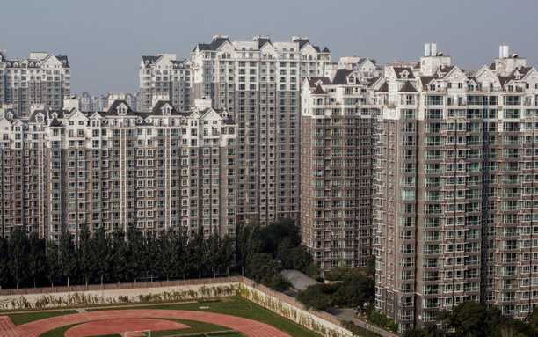
Committed emissions from new buildings
Shown: Yanjiao, China
Most power-plant electrons go to buildings. Less demand for heating, cooling, and appliances – fewer power plants.
*4. “Committed emissions” prioritizes low-carbon industrialization.
Notes:
The World Bank has no program on air conditioning.

Slide 17
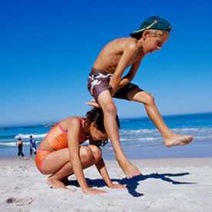
Leapfrogging
Developing countries used to be unwilling to do something before it was proven in the industrialized countries. They didn’t want to be guinea pigs. This is changing. For example, China is leapfrogging over the rest of the world with high-voltage transmission.
5. The developing world will decide what kind of planet we live on.

Slide 18
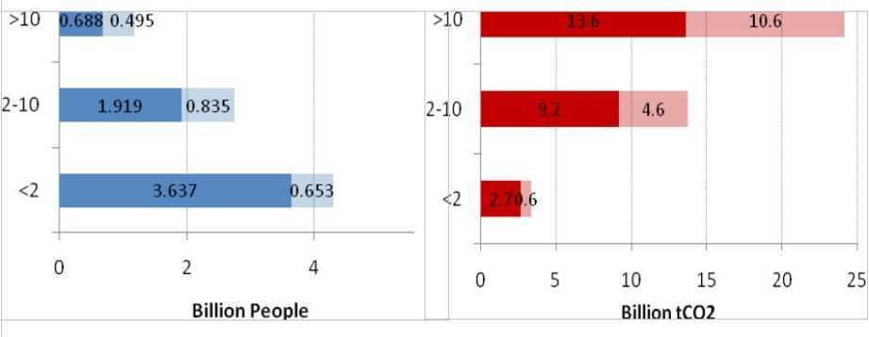
One billion high emitters
0.7
0.5
14
11
1.9
0.8
2003
2003-30
9
5
3.6
0.7
3
1
1.2 billion “high emitters” in 2030.
Bin boundaries at 2 tCO₂/yr and 10 tCO₂/yr are the 2003 per capita values for Brazil and EU. Most high emitters are not “rich.”
Collaborators: Shoibal Chakravarty and Massimo Tavoni.
Source: http://www.climatescienceandpolicy.eu/2009/11/afocus-on-individuals-can-guide-nations-towards-a-low-carbon-world/
Notes:
These totals don’t exactly agree with the values used in the One Billion High Emitters Paper.
Here the (2003,2030 ) values are (6.24, 8.22) billion people, vs. (6.24, 8.11) in OBHE; and (25.5, 41.3) GtCO2 vs (26, 43) in OBHE.

Slide 19
Where do the high emitters live?
More than half of the 2030 high emitters are projected to live outside the OECD.
>10
The high-emitter lifestyle is similar across the world. Best practices pioneered in one country can spread.
The “Paris” process can help: participants show off their best dishes.
2-10
<2
6. “Paris,” a potluck dinner, can help drive a race to the top.
Notes:
19

Slide 20
“Solutions”
There are still many options. Is it already time to declare a winner?
Options can be more dangerous than climate change.

Slide 21
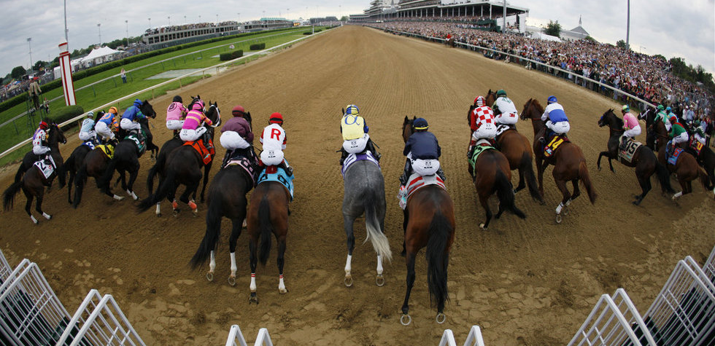
Stabilization wedges… in 2004
2011 Kentucky Derby, AP Photo/Matt Slocum. https://www.cbsnews.com/pictures/2011-kentucky-derby/7
Slide pair: courtesy of Greta Shum, Andlinger Center, Princeton University

Slide 22
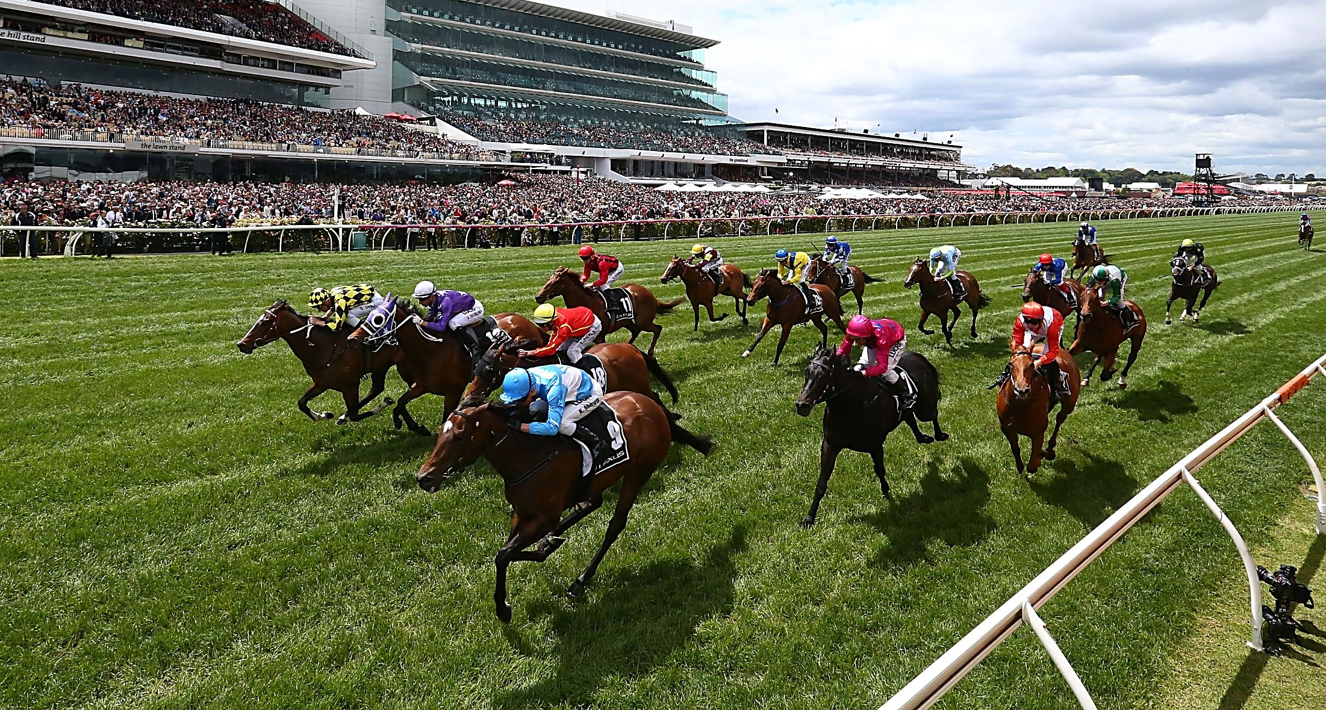
Stabilization wedges… in 2018
end-use efficiency
H₂ for
fuel
CCS
gas for coal
biological
nuclear
efficient
coal plants
wind/solar
storage!
*7. Solar and wind have raced ahead.
Melbourne Cup, The Foreign Correspondents‘ Club, Hong Kong. https://www.fcchk.org/event/melbourne-cup
Notes:
Global Installed Capacity (GW)
2004 to 2017
Solar 3 to 300
Wind 40 to 500
Hydrogen at the back… maybe lame
Storage as the dark horse

Slide 23
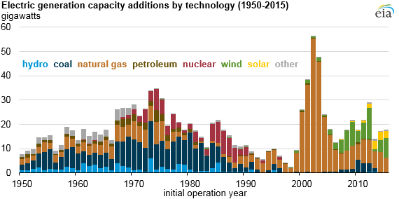
U.S. power plants: Replaced by what? When?
Age: 40.
Relicensing?
Early retirement?

Slide 24
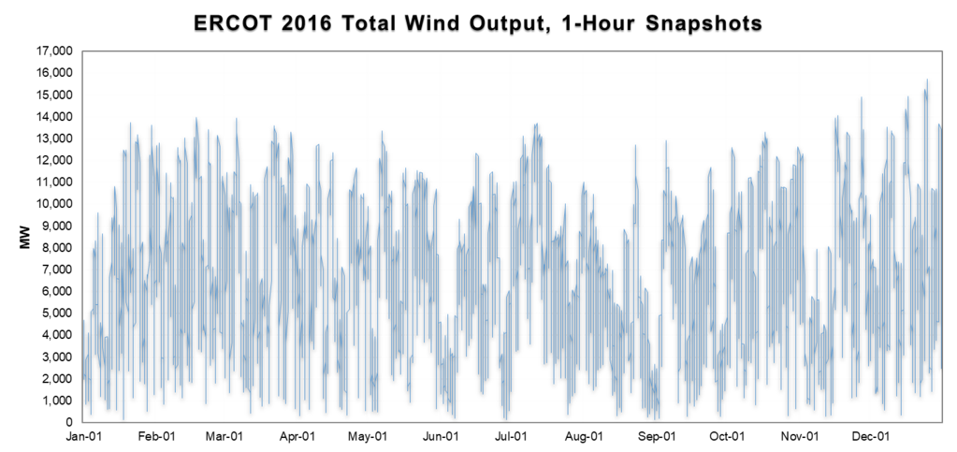
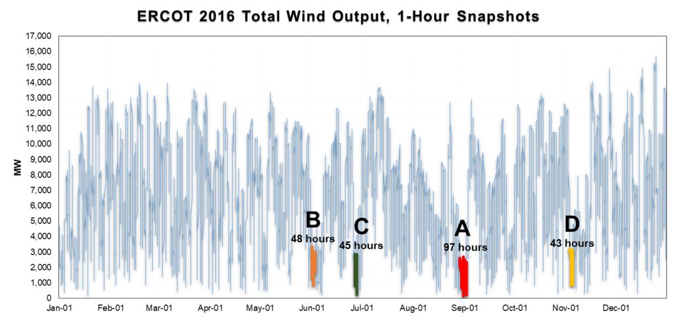
Wind Power: Low-Output Analysis (LOA)
A, B, C, and D mark the four longest periods with wind power output below 3GW, half of the annual average (6 GW). Installed capacity: 17GW.
50% of annual average
Wind accounted for 15% of 2016 ERCOT (roughly, Texas) electricity production. Wind expansion could be thwarted by events like A-D.
Figure and analysis courtesy of Pedro Haro.
Notes:
The numbers are: wind installed capacity was 16 GW (beginning of the year) and 17.5 GW at the end. Average wind installed capacity is 17.1 GWe. Average wind generation is 6.0 GWe. The average capacity factor is 35.5%. The average total demand is 40.0 GWe. The peak hourly demand was 71.2 GWe. The minimum demand was 25.0 GWe.
Pedro

Slide 25
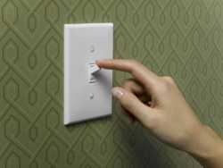
Rapid Switch:
How quickly can change occur?
How quickly can solar and wind gain market share? How quickly can coal lose market share?
What limits how quickly social norms can change?
  Wind and solar intermittency will make us aware of time in new ways and increase our engagement with nature. How strongly will we resist?
History is useful: How quickly did automobiles displace horses? Why neither faster nor slower?
What goes wrong when change is attempted too quickly?
8. “Rapid Switch” (the pace of change) is ripe for academic inquiry.

Slide 26
Every “solution” is dangerous*.
* I choose the word with Rio in mind.
Every strategy can be implemented well or poorly
    Nuclear power Nuclear war
Biocarbon Competing uses of land
Geoengineering Technological hegemony
“Clean coal” Mining: worker and land impacts
Wind and solar Unreliability
Conservation Regimentation
It is essential to identify the “conditionalities” that make a solution less dangerous.
Risk management reappears: It is possible to achieve 2ºC and regret doing so. “Two-sided reasoning” weighs both the threat and the “solutions.”
Notes:
26

Slide 27
Conditionality for nuclear power
  Nuclear power is coupled inevitably to nuclear weapons. Alas, in the past two decades, nuclear weapons have become more desired. Thus, a condition for the deployment of nuclear power to address climate change needs to be that it leads away from, not toward, national nuclear weapons programs.
  The Iran deal shows the extent to which sovereignty must be compromised to sever the connection between nuclear power and nuclear weapons. The logic of the Iran deal points toward the internationalization of nuclear power – especially the “fuel cycle” – including for the U.S.
9. A nuclear war is a poor trade for the slowing of climate change.

Slide 28
Conditionality for biocarbon
What will go wrong if we move headlong to maximize global biocarbon stocks without conditionalities?
Suppose you were a forester or an agronomist in a world where the carbon price was very high. You were told that storing carbon was your only objective. What would you do? Establish a monocrop? Pour on fertilizer? Be inventive.…

Slide 29
Conditionality for biocarbon
What will go wrong if we move headlong to maximize global biocarbon stocks without conditionalities?
Suppose you were a forester or an agronomist in a world where the carbon price was very high. You were told that storing carbon was your only objective. What would you do? Establish a monocrop? Pour on fertilizer? Be inventive.…
Now, change roles. You are the policy maker in the same world. What conditionalities would you place on the carbon market for biostocks in the interest of eliciting actions you would welcome and deterring outcomes you would decry?
10. The biosphere is at risk at $100/tC0₂.
Notes:
$100/tCO2 ≈ $400/tC ≈ $200/t biomass. Compare with $200/t wheat and $50/t logs

Slide 30
Geoengineering by imitating volcanoes
On June 15, 1991 (three days after this photo), Mt. Pinatubo injected 10 million tons of sulfur into the stratosphere.
The Earth’s average surface temperature was 0.5ºC cooler six months later, then rebounded.
Cooling the Earth deliberately by perpetually injecting sulfur particles into the stratosphere is an example of “geoengineering” (also called “solar radiation management”).
Notes:
Crutzen estimates that maintaining ≈5 MtS in the stratosphere as sulfate aerosols indefinitely would cancel the warming due to CO2 doubling.

Slide 31
Engineered Earth
In a fully engineered planet:
There may be no way back.
There is no obvious political process that will reconcile contending goals.
Taking other species into account will create conflict; many species depend on the extreme events we find unpleasant and costly.
11. Beware of using geoengineering to remove highs and lows; it will eradicate the evolutionary niches of countless species.

Slide 32
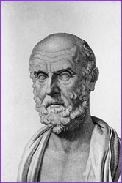
Patient Earth
“I will apply, for the benefit of the sick, all measures that are required, avoiding those twin traps of overtreatment and therapeutic nihilism.”
Hippocrates
*12. The lowest conceivable greenhouse targets, achievable only by casting caution to the winds, are not optimal.
* Modern version of the Hippocratic oath, Louis Lasagna, 1964, http://www.pbs.org/wgbh/nova/doctors/oath_modern.html
Notes:
Medical choices are more complicated now. Most of us have been here, with a friend or relative at least. Strong drugs with side effects, very sick patients.

Slide 33
Twelve truths
We wish Earth were larger.
Judgments about which fossil fuels are “unburnable” have no precedents.
* Risk management demands a global climate science effort that gives greater priority to extreme outcomes (the “tails”).
*“Committed emissions” prioritizes low-carbon industrialization.
The developing world will decide what kind of planet we live on.
“Paris,” a potluck dinner, can help drive a race to the top.
* Solar and wind have raced ahead.
“Rapid Switch” (the pace of change) is ripe for academic inquiry.
A nuclear war is a poor trade for the slowing of climate change.
The biosphere is at risk at $100/tCO₂.
Beware of using geoengineering to remove highs and lows; it will eradicate the evolutionary niches of countless species.
* The lowest conceivable greenhouse targets, achievable only by casting caution to the winds, are not optimal.
Can such points of departure – and many comparable ones – enable a more constructive conversation about climate change?

Slide 34
Homage to Princeton University
Its values: Rigor, engagement, independence, global reach, collegiality, irreverence, moral compass.
Its scholar-friends: Steve Pacala, Bob Williams, Frank von Hippel, and many more.
Its homes: MAE, PEI, Andlinger, WWS-STEP.
Its young people: undergrads, graduate students, post-docs. They replenish the spirit (“it’s up to us”). They take the baton.
What will be in their talks in 2068?

